Slide 1
I am a Painter Myself
Group 25:
Ruize Xu
Jianping Ye
Lichuan Zhang
Notes:
Hello Everyone , We are group #25, My name is Lichuan Zhang, my teammates are Jianping Ye and Ruize Xu. Our project for the course is “I am a painter myself”

Slide 2
Content
Introduction & Motivation
Methodology
Datasets
Data splitting and preprocessing
Exploratory Data Analysis
Modeling
Cycle-Consistent Adversarial Network: CycleGAN
Discover Cross-domain Adversarial Network: DiscoGAN
Neural Style Transfer
Hyperparameter Tuning
Results and Evaluation
Notes:
Here is a brief guideline of our presentation. Firstly We are going identify what challenge we are trying to solve, and then more details of how we pre process our data. After that we are going to describe the three models we tried out. And finally, we are going to show the result and analyze the advantage of these models as well as their disadvantages.

Slide 3
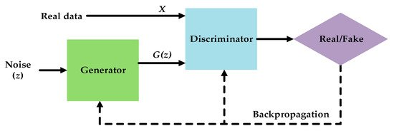
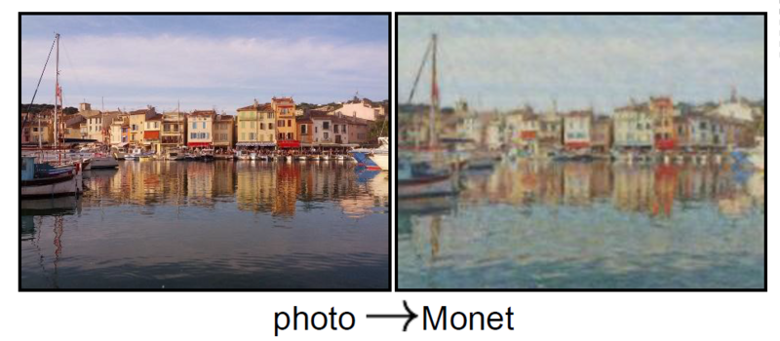
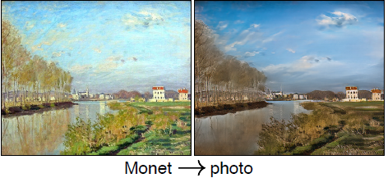
Introduction
The project is one of the on-going competition on Kaggle
Goal : Generate Monet style pictures from photo
Using Generative Adversarial Network
Notes:
Let me first start by defining our project. Our project is one of the on-going competition on Kaggle. The main challenge in this competition is to generate Monet style pictures from photo taken from real life. Here’s two examples of transferring real photo to Monet style and vice versa. General Adversarial Network, or GAN, is used for this task. A GAN consist of two models. A generator where it generate the picture from feature space, and a discriminator which classify the difference between an actual and an artificial Monet picture. Then the output of the discriminator become the loss of generator model for backpropagation. The Generator is trying to create picture that is similar to real data so it will be harder for the discriminator to classify, therefore reach a lower loss and better generative performance.
[1]https://www.mdpi.com/2072-4292/12/7/1149
[2]https://developpaper.com/cyclegan-for-image-conversion/

Slide 4
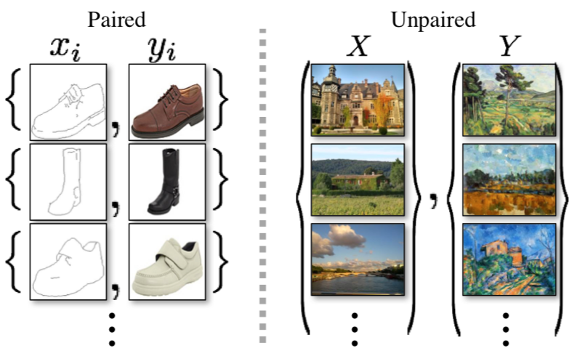
Challenge with Data
Most of the data are unpaired images
No labels available
Pictures do no match
Notes:
However for our task, there’s a challenge with data. For most of the computer vision dataset, the data are paired, meaning that either there will be a unique label assigned to every picture, or there is a one to one relationship between the input pictures and output pictures. But for the style-transfer task, there’s no strictly one to one relationship or labels available. As you can see from the graph, paired image only different in certain features like color, but still preserve the shape. For the unpaired images, two sense from input and output image are totally different. This make the competition a tougher task because it’s hard to define the loss for the model.
Reference
[https://towardsdatascience.com/cyclegan-how-machine-learning-learns-unpaired-image-to-image-translation-3fa8d9a6aa1d]

Slide 5
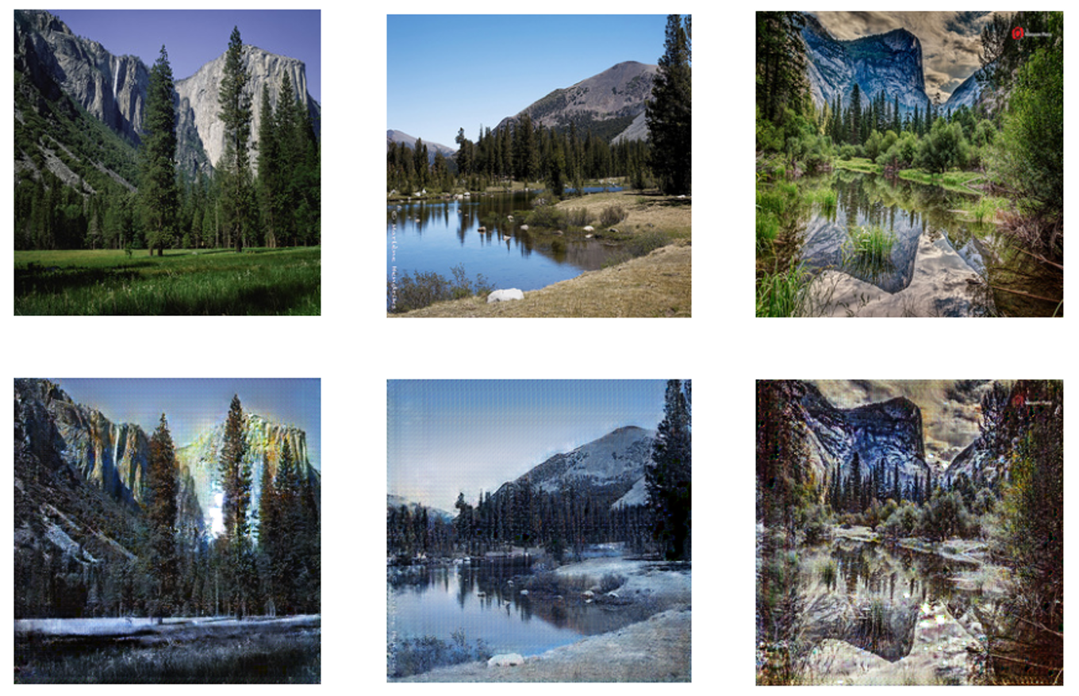
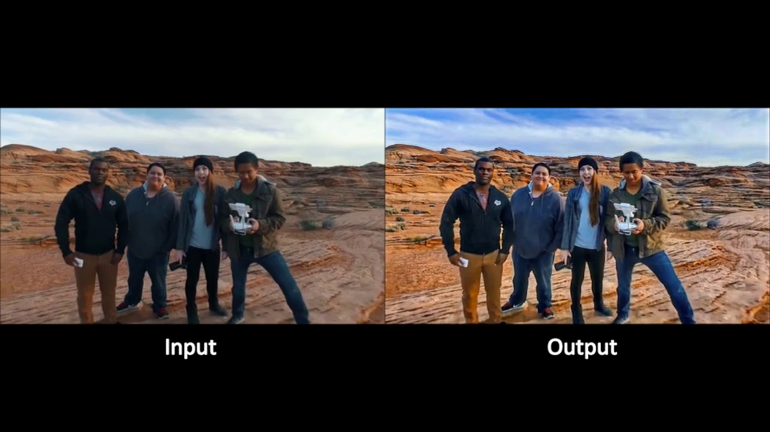
Motivation
Season Transfer
Photo Enhancement
Notes:
Despite from being hard to train, there’s a broad range of applications that can use this technology. For example, there’s season transfer which can change the season inside a picture. Another example can be photo enhancement. The algorithms can be used to increase the depth of the photo and it dynamic range. So the output image has more details compare to the input image, while not experience common issue that we would see in traditional photo enhancement method. Next , Jianping is going to give more details about the dataset and data pre-processing.
[1]https://medium.com/@viswajith.madhuram/cyclegan-for-season-transfer-61b92ba23b4b
[2]https://paperswithcode.com/paper/deep-photo-enhancer-unpaired-learning-for
[idea]https://machinelearningmastery.com/what-is-cyclegan/

Slide 6
Datasets
The dataset is obtained from Kaggle competition “I’m something of a painter”
Monet’s paintings and photos, in JPEG and TFRecord format
300 Monet’s paintings + 7028 photos, sized 256*256
Extra 1193 Monet’s painting obtained from another Kaggle dataset
To avoid repetition, the extra Monet dataset is used along with the photo dataset of Kaggle competition
Notes:
The competition comes with 300 Monet’s paintings and over 7k photos with dimension of 256 by 256. While developing the models, we attempted to improve accuracy by including a new Monet dataset of 1193 paintings. To avoid possible repetition between the extra Monet dataset and the original competition dataset, we use the new one instead.

Slide 7
Data Splitting & Preprocessing
Train-test split: 90% : 10%
Train set: 1073
Test set: 120
Data augmentation technique to reduce overfitting
Random horizontal flipping
Random resizing
Random clipping
Data Normalization
Pixel values are scaled between -1 and 1
Note: Data augmentation done on train set only, test set should only be normalized
Notes:
Firstly, we performed data splitting and preprocessing. The train-test set were separated in a 90% to 10% ratio. That leads to 1073 training samples and 120 testing samples. A series of data augmentation techniques were adopted as a form of regularization, including randomly flip the images horizontally, resizing then finally clipping it back to original size randomly. Finally, we scaled the pixel values between -1 and 1. It’s worth noticing that data augmentation should only be done on training data, while the test set only need to be normalized.

Slide 8
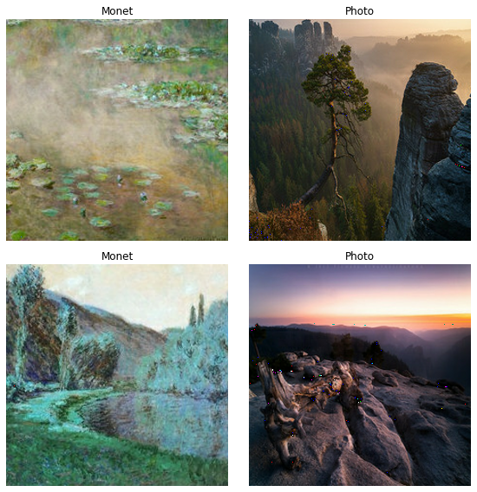
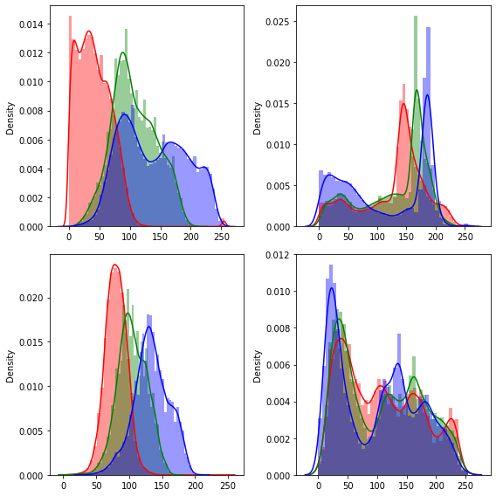
Exploratory Data Analysis
Notes:
Then we proceed to exploratory analysis stage. As we’re working on image data, there isn’t much to be done here. The first set of figure shows comparison between Monet’s painting and photos. We can clearly observe the difference in their style representation. We also plot the color channel distribution of these four images.

Slide 9
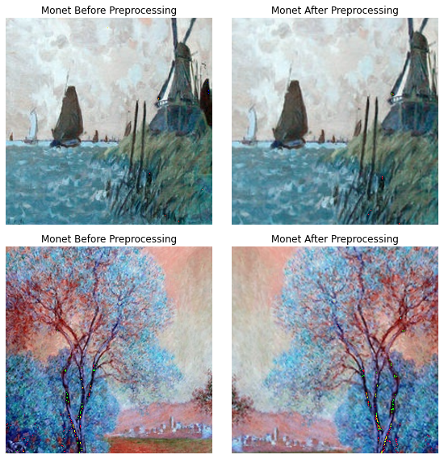
EDA Cont’d
Notes:
This plot demonstrates the effects of data augmentation. As you might notice, the second column is a slightly more close-up version to the first one, that’s due to resizing and then cropping back. The image below has opposite orientations.

Slide 10
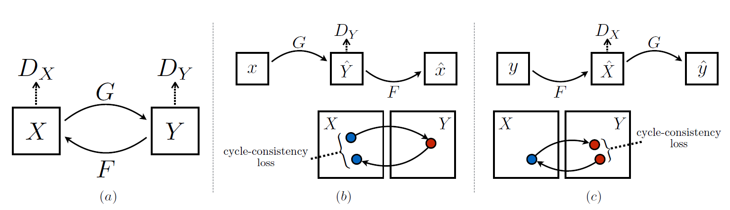
Modeling - CycleGAN
Cycle-Consistency loss
Two Generator-Discriminator pairs
Collection image translation
Source
Notes:
Let’s get to the models. First one is called cycle-consistent adversarial network, CycleGAN, named after the cycle-consistent loss function. It has two generator-discriminator pairs. The generator G is responsible for generating images from domain X to domain Y, while generator F do the opposite. This is where cycle-consistent loss comes into play. When generator G produces image in domain Y, let’s call it Y head. Y head is then feed into generator F to produce image in domain X, let’s call this X head. Naturally, we would expect X head to be as close as possible to X. Imagine you would like to translate an English sentence to French, and translate it back to English, we should arrive at the original sentence. The difference between X and X head is defined as cycle-consistency loss. The discriminator X will try to distinguish real X from fake X, and discriminator Y will try to distinguish real Y from fake Y.

Slide 11
CycleGAN - Architecture
Generator
ResNet - Residual connections
Downsampling by strided Conv2D blocks, then upsampling by Conv2DTranspose, ‘same’ padding
ReLu activation, except the output layer is tanh
Instance normalization
Discriminator
PatchGAN: discriminator that penalizes locally on a N*N image patches (70*70)
Conv-Instance Norm-Leaky ReLu blocks
Notes:
The CycleGAN generator adopts a ResNet structure featuring residual connections. One of the core components is strided convolution block, and transposed convolution blocks, while leaving the edge unpadded. ReLu activation is used throughout except in the last output layer is a tanh. As the batch size is set to 1, instance normalization is used. The discriminator is a PatchGAN structure, which instead of penalizing the entire image, it tries to classify each N*N block in an image is real or fake, typically 70*70. Each downsampling block in discriminator consists of a conv-instance normalization-leaky ReLu structure.

Slide 12
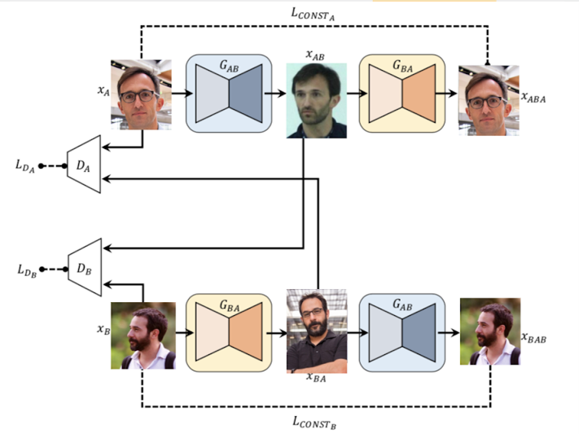
Modeling - DiscoGAN
Similarities to CycleGAN:
Collection image translation
Two generator-discriminator pairs
Differences to CycleGAN:
Encoder-Decoder
Fully-connected layers in discriminator
2 Reconstruction loss
Source
Notes:
Next, let me give you a brief introduction to DiscoGAN. The paper of CycleGAN and DiscoGAN were basically published at the same time, but somehow CycleGAN are much more widely known and used than DiscoGAN. However, DiscoGAN still shares a lot of similarities to CycleGAN. It is used widely in collection image translation as well. It also seeks to have two GANs that “can map each domain to its counterpart domain”, and “distinguish one domain from the other”. The picture on the right in this slide demonstrates the main idea of this model. Similar to CycleGAN, if we take a input image A, use the first generator to transfer it into image B. Then if we use the second generator to transfer image B, we are expected to get back to where we start from. Meanwhile, the differences to CycleGAN are also obvious. First, it uses the same encoder and decoder as what normal Deep convolutional GAN uses. No other complex structure in it. Second, DiscoGAN does not use residual connections like CycleGAN. It uses fully-connected layers as output in discriminator. Third, it uses two reconstruction loss for 2 generators. In some scenarios, the model may encounter mode collapse problems. Mode collapse refers to scenarios that different input images may be mapped to the same output image. This extra loss function can solve this issue notably.

Slide 13
DiscoGAN - Architecture
Generator
Simple and straightforward Conv-deconv Encoder and Decoder
Leaky ReLu in encoder, ReLu in decoder
Batch normalization
No residual connection
Discriminator
Structures are mostly similar to DCGAN
Leaky ReLu
Notes:
Here’s some details of our DiscoGAN’s architecture. The generator uses a pair of simple and straightforward conv-deconv encoder and decoder. For the activation function, encoder uses leaky relu while decode uses relu. The generator also involves batch normalization. Unlike CycleGAN, it does not implement the residual connection. For the discriminator, most of the structures are very similar to DCGAN, and Leaky relu as the activation function.

Slide 14
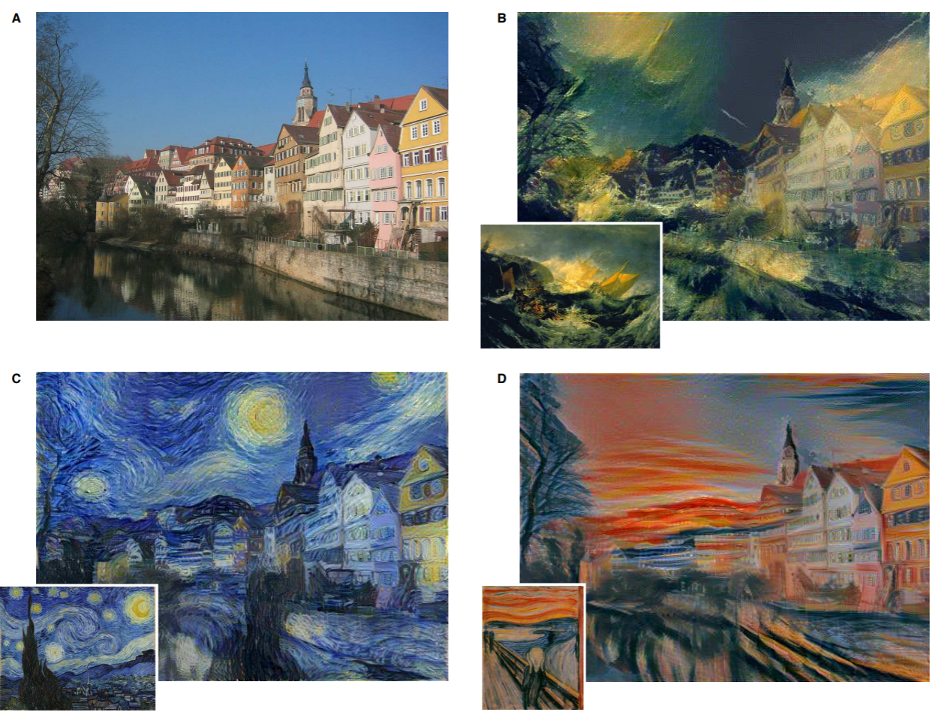
Modeling - Neural Style Transfer
VGG 19 pre-trained on ImageNet
Base image + style reference image = translated image
One-to-one case-specific translation
source
Notes:
The two methods that Jianping and Ruize had described uses newly developed models that performs well with style transfer task. I’d like to show some other approaches. The neural style transfer model is developed before CycleGAN, it has a fairly good output for this task. The model takes the advantage of VGG 19, which is a model that is intended for classifying objects. The model is trying to blend the style reference image into the content image. However, we have to notice that this is a one to one image specific translation. Providing different style reference image would result in different output.

Slide 15
NST - Cont’d
Feature extraction model --> retrieves the intermediate activations of VGG19
Total loss = style loss + content loss + total variation loss
Style loss = L2 distances between the Gram matrices of feature maps from the style image & output image, extracted through Conv net
Content loss = L2 distance between content image & output image
Total variation loss: regularization loss on the high frequency components, impose local spatial constraints
Gradient descent
Notes:
So how does this model works. At first, we need to extract some features from the image. The feature extraction model uses several intermediate layers in VGG19 to generate style output and content output from the input image. Then we need to define the loss of the model. We have three loss combined for our final loss. They are style loss, content loss and total variation loss. The Style loss is the L2 distance between Gram matrices of feature maps from the style reference image and output image. The gram matrices is a measure of means and correlations across different feature maps. Content loss is the L2 distance between the content image and output image. At last, we add total variation loss which is calculated from the high frequency component of the image. It is used to reduce the artifacts that happened commonly on high frequency component. This generally makes the picture looks smoother. After defining three losses, we can then using gradient descent to find a output image that minimize these loss and generate our final output. Now I’ll let Ruize to talk about hyper parameter tuning.

Slide 16
Hyperparameter Tuning
Model | Hyperparameter | Values Tested | Values Selected
CycleGAN | Number of Conv & ConvTranspose blocks in generator | 1, 2, 3 | 2
DiscoGAN | Number of iterations | 200, 500, 1000 | 500
DiscoGAN | Learning rate | 0.0002, 0.0004 | 0.0002
Neural Style Transfer | Number of iterations | 1000, 1500, 2000 | 1000
Notes:
This table shows the hyperparameter tuning result. For CycleGAN, we tested the Number of Conv & ConvTranspose blocks in generator with 1, 2,3 and 2 was selected. For DiscoGAN, we tuned two hyperparameters. The first one is number iterations, we tested 200, 500 and 1000 and 500 was selected. The other one is learning rate. We tested 0.0002 and 0.0004, 0.0002 was chosen. For Neural Style Transfer, we tuned the number of iterations. We tried 1000,1500 and 2000. 1000 turned out to be the optimal value.

Slide 17
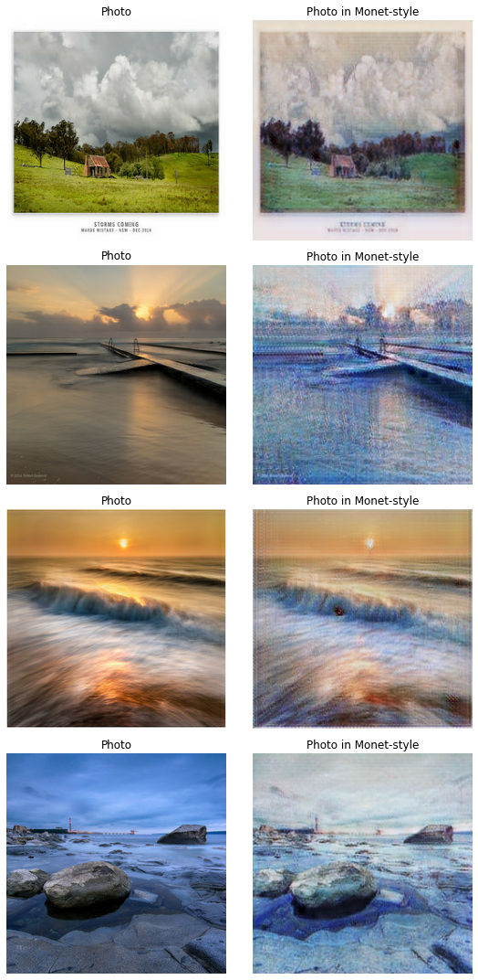
Results - CycleGAN
Notes:
OK, let me show you the pictures we have obtained from the trained models. In this section, we will judge them by only looking at them to see the visual difference. We will include the data analysis after this. These are from our first model, CycleGAN. It is observed that the model is capable of detecting color segments. Original object boundaries are maintained and properly translated. As we can see, the first one and the fourth transformation seems to be very good. While the third one has a lot of noises, and affects its quality.

Slide 18
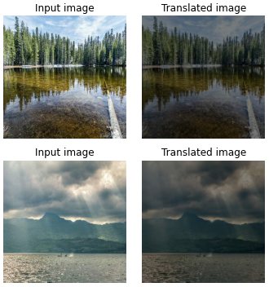
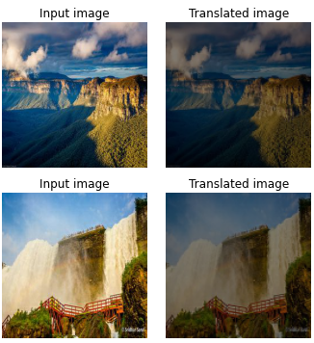
Results - DiscoGAN
Notes:
These are from our second model, DiscoGAN. As we can see in this slide, DiscoGAN can learn some of the features from Monet’s paintings. The translated images are visually different from those original photos. Although there are some certain colors tend to be much darker than the input images.

Slide 19
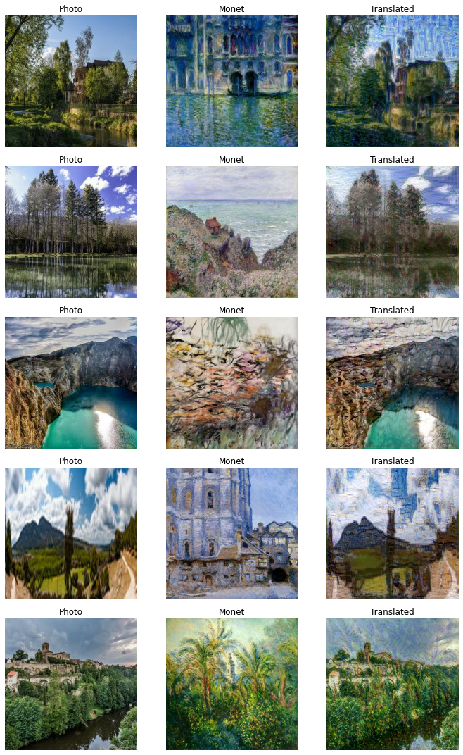
Results - Neural Style Transfer
Notes:
And these are from our third model, nst. The produced images are visually different than CycleGAN. The model is able to blend the style reference image into the content image. However, original color segments and object boundaries are also blended which result in slightly worse visual effects than CycleGAN.

Slide 20
Performance Metrics
Inception Score (IS)
Use a pre-trained deep neural network, inception v3, for image classification to classify the generated images
The probability of the image belonging to each class is predicted
Captures two aspects of generated images: Quality & Diversity
Score correlated well with subjective evaluation
Frechet Inception Distance (FID)
Compare statistics of a collection of synthetic images to that of a collection of real images from the target domain, i.e.: synthetic Monet-style photo vs. real Monet
capture similarity between synthetic images and real images from target domain
Use Inception v3 as well
Human Subjective Evaluation
Notes:
Now let's talk about some quantitative metric to evaluate our output. We uses Inception score and Frechet(FreKet) inception distance. Both of the two metrics use inception v3. Inception score are good with capturing quality and diversity of the image, it is calculated by how many object the Inception v3 model can recognize from the image. The more objects it can recognize, the better the output image would be. Frechet Inception score is the average distance between the output image and image in target domain. This metric is good for capturing similarity between synthetic and real image from within the target domain. However Inception score correlates well with the human subjective evaluation,thus it will be a primary score for our quantitative performance metrics.

Slide 21
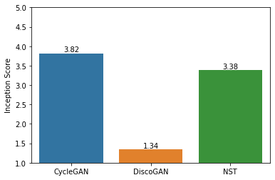
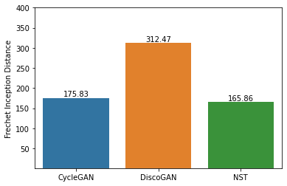
Metrics Results
Notes:
Here’s the result we obtained from cycle gan, disco gan and neural style transfer. For a better appearance, the model need to have a high inception score and low frechet inception distance. We see that cyclegan performs best among the three models because it got highest Inception score with relatively low frechet inception distance. Next Jianping is going to provide an analysis on these three models.

Slide 22
Analysis
CycleGAN
Satisfactory results but difficult and time-consuming to train
Collection transfer: no need to find proper matching between base image and style image
Residual connections alleviate vanishing gradients
PatchGAN in discriminator allows modifying local style statistics more effectively
DiscoGAN
Relatively simpler structure might lead to less convincing results
More susceptible to mode collapse and unstable gradients
Notes:
It’s observed that CycleGAN produces generally satisfactory results with some fail cases. It also comes with a cost – as the network is complicated, it’s difficult to fine-tune and very time-consuming to train. But its advantage is that it can collectively learn the style representation of a group of images without worrying to find a proper match between base image and style image. The reason why it’s performing well might due to its ResNet structure. It allows gradients to flow directly over a few layers away to alleviate vanishing gradients, without passing non-linear activation functions, Also, PatchGAN in discriminator allows modifying local style statistics more efficiently.
It is suspected that due to relatively simpler structure used in DiscoGAN, the results are less convincing, and the training process is more susceptible to mode collapse and unstable gradients.

Slide 23
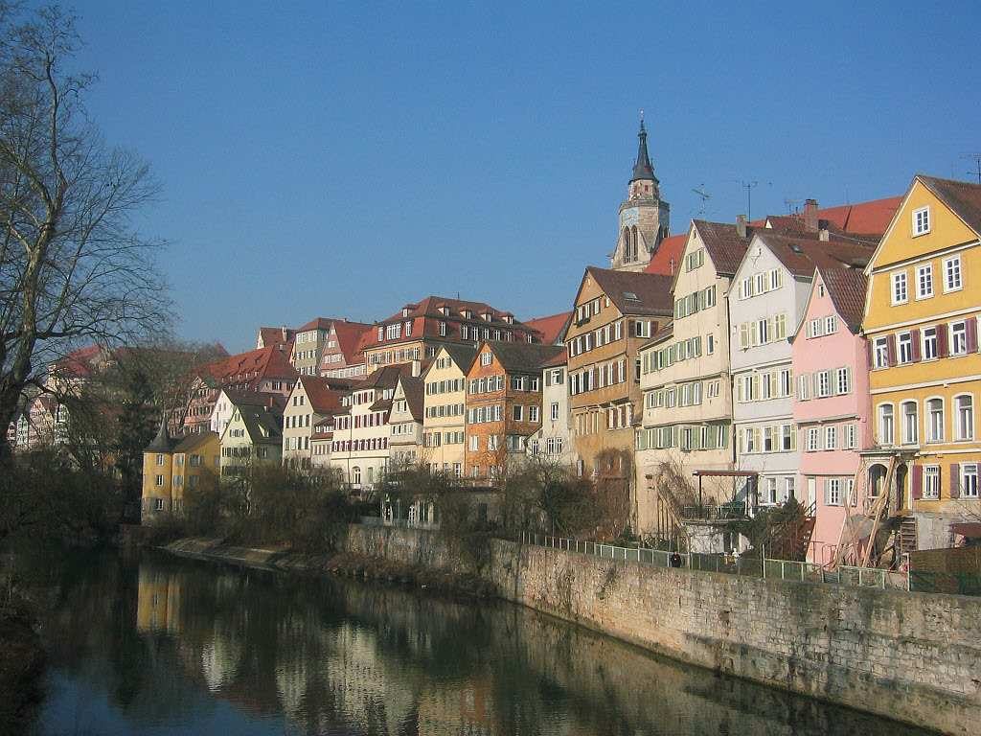
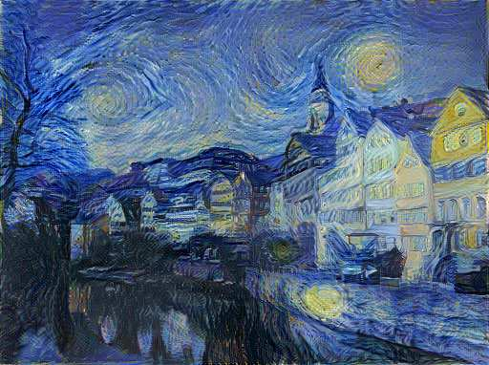
Analysis - Cont’d
Neural Style Transfer
The translated image has infinite possibilities depends on what style reference image you select
However, style image may require manual pruning and careful selection
The translated image will always carry some “shadow” of the style image
Translated image using Van Gogh’s ‘Starry Night’
Notes:
In neural style transfer, we can have infinite possibilities in the translated images, depending on which style image you nominated. The flexibility also creates another issue. This approach may require manually pruning and selecting the most appropriate style reference image such that the produced output is reasonable. In other words, it’s case-specific translation, largely depends on chances. For instance, a base image with daylight background can’t be translated using a style image that is depicting evening. In addition, the translated image will inevitably carry some characteristics of the style image. From these two images we can see the style is obvious, Van Gogh’s starry night, because it’s sort of blended into the base image. Nonetheless, it might look like a replica but not creation.
Overall, we find CycleGAN is the most suitable model for the task. In subjective evaluation, we think images generated by CycleGAN are the most desired outcome.

Slide 24
References
Jun-Yan Zhu, Taesung Park, P. Isola, and A. A. Efros, “Unpaired Image-to-Image Translation Using Cycle-Consistent Adversarial Networks,” in 2017 IEEE International Conference on Computer Vision (ICCV), 2017, pp. 2242–2251, doi: 10.1109/ICCV.2017.244.
T. Kim, M. Cha, H. Kim, J. K. Lee, and J. Kim, “Learning to Discover Cross-Domain Relations with Generative Adversarial Networks,” 2017.
L. Gatys, A. Ecker, and M. Bethge, “A Neural Algorithm of Artistic Style,” Journal of vision (Charlottesville, Va.), vol. 16, no. 12, p. 326–, 2016, doi: 10.1167/16.12.326.
“I'm Something of a Painter Myself,” Kaggle. [Online]. Available: https://www.kaggle.com/c/gan-getting-started. [Accessed: 20-Mar-2021].
P. Isola, Jun-Yan Zhu, Tinghui Zhou, and A. A. Efros, “Image-to-Image Translation with Conditional Adversarial Networks,” in 2017 IEEE Conference on Computer Vision and Pattern Recognition (CVPR), 2017, pp. 5967–5976, doi: 10.1109/CVPR.2017.632.
Notes:
Here are some of our references. Thank you for you time.

Slide 25
Thank you!

